Slide 1
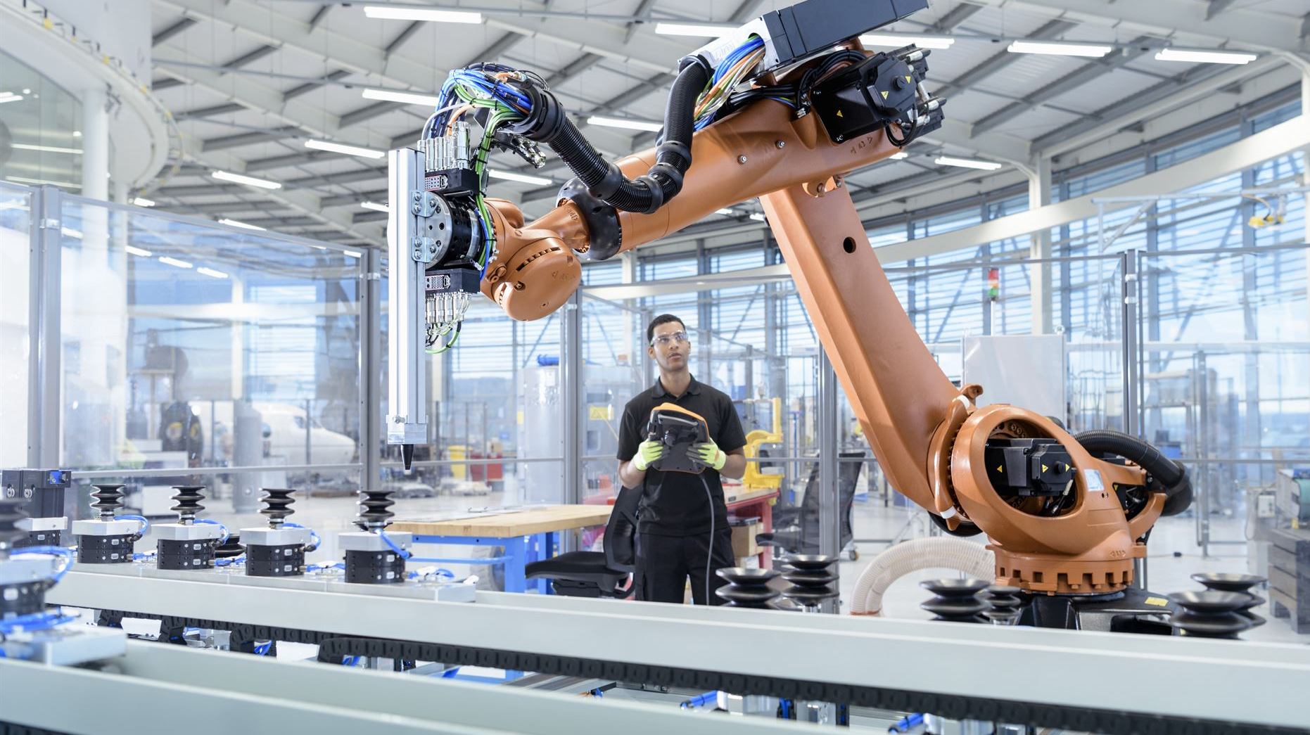
Successful Real-World Cases in RPA
Exploring RPA's impact across various industries
Notes:
---
In this presentation, we will explore successful cases of Robotic Process Automation (RPA) in various industries, highlighting real companies that have leveraged RPA to enhance efficiency and reduce costs.

Slide 2

Presentation Agenda
Introduction to RPA
  We will start with an overview of Robotic Process Automation (RPA) and its significance in modern business.
Applications in Industries
  Next, we will explore various applications of RPA across different industries, showcasing its versatility and benefits.
Case Studies of Success
  Finally, we will discuss specific case studies of companies that have successfully implemented RPA, highlighting their achievements.
Notes:
This presentation will first introduce the concept of RPA, followed by discussing its applications across different industries. Finally, we will delve into specific case studies of companies that have successfully implemented RPA.

Slide 3

Introduction to RPA
What is RPA?
  RPA, or Robotic Process Automation, involves using software robots to automate repetitive tasks across various applications.
Benefits of RPA
  Implementing RPA helps businesses streamline their processes, reduce errors, and enhance overall efficiency.
Human Resource Optimization
  By automating routine tasks, RPA frees up human resources to focus on more strategic and value-added activities.
Notes:
RPA is a technology that uses software robots to automate routine tasks. It allows businesses to streamline processes, minimize errors, and free up human resources for more strategic tasks.

Slide 4
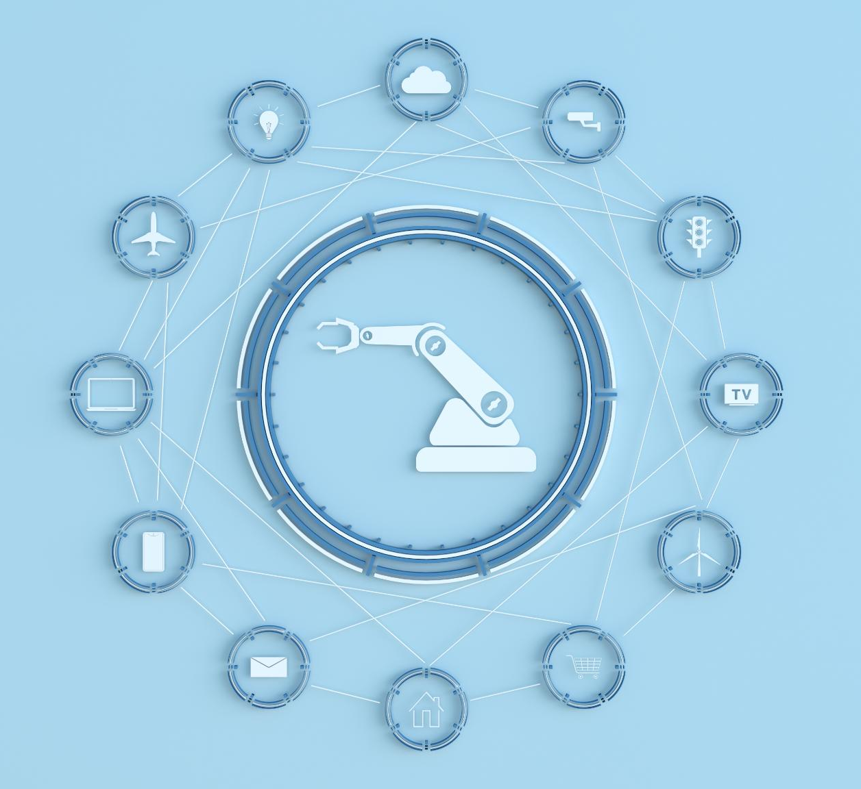
Benefits of RPA
Increased Efficiency
  RPA significantly enhances operational efficiency by automating repetitive tasks, allowing employees to focus on higher-value activities.
Reduced Operational Costs
  By automating processes, organizations can reduce operational costs, minimizing the need for manual labor and decreasing errors.
Enhanced Accuracy
  RPA improves accuracy by eliminating human errors in data entry and processing, resulting in higher quality outputs.
Improved Compliance
  RPA helps organizations maintain compliance with regulations and standards by ensuring consistent and reliable execution of processes.
Notes:
The main benefits of RPA include increased efficiency, reduced operational costs, enhanced accuracy, and improved compliance. It enables organizations to scale processes without affecting service quality.

Slide 5

Industry Applications of RPA
Finance Sector
  In finance, RPA helps automate repetitive tasks like data entry, invoice processing, and compliance reporting, enhancing efficiency.
Healthcare Applications
  RPA in healthcare streamlines patient data management, billing, and appointment scheduling, improving service delivery and accuracy.
Retail Efficiency
  Retail businesses use RPA to manage inventory, process orders, and enhance customer service, leading to better customer experiences.
Manufacturing Processes
  In manufacturing, RPA streamlines supply chain management, production scheduling, and quality control processes, boosting productivity.
Notes:
RPA is applied across various industries, including finance, healthcare, retail, and manufacturing. Each sector leverages RPA to address specific operational challenges and improve workflows.

Slide 6
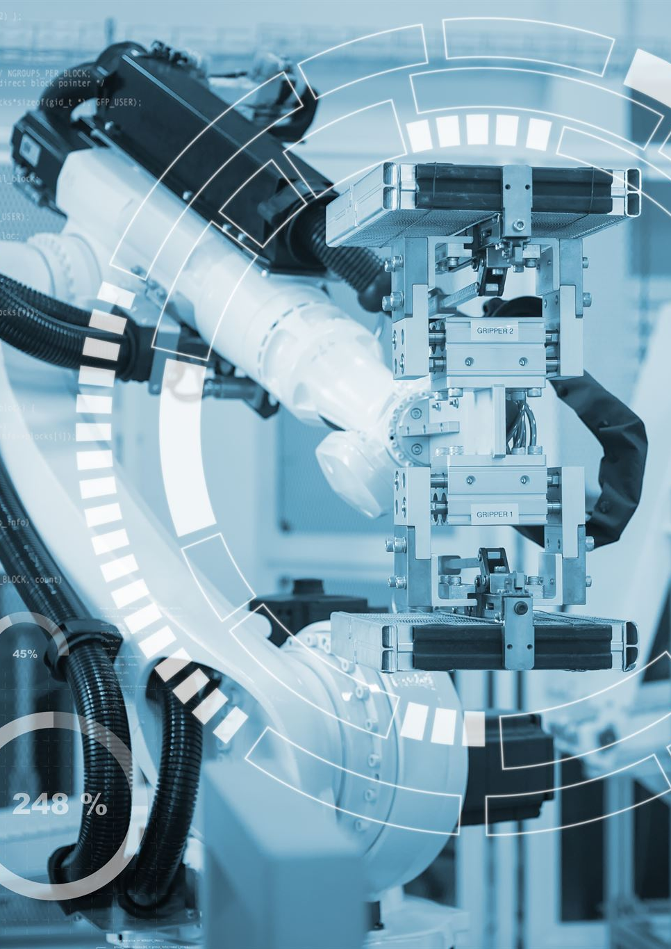
Finance Industry Example
Automation of Tasks
  RPA helps automate repetitive financial tasks, improving efficiency and reducing human error in processes like transaction processing.
Compliance Checks
  RPA is utilized in compliance checks to ensure adherence to regulations, enhancing accuracy and speed in the finance sector.
Report Generation
  Automating report generation with RPA saves time for finance professionals, allowing them to focus on strategic tasks.
Notes:
In the finance industry, RPA is used to automate repetitive tasks such as transaction processing, compliance checks, and report generation, leading to significant time savings.

Slide 7

Case Study: UiPath with Deloitte
RPA Implementation
  Deloitte successfully implemented Robotic Process Automation (RPA) to streamline its financial services operations.
Process Automation
  The automation of over 40 processes significantly enhanced operational efficiency and reduced errors.
Time Reduction
  Deloitte achieved a remarkable 75% reduction in processing time across automated tasks, leading to faster service delivery.
Improved Accuracy
  The implementation of RPA not only sped up processes but also improved accuracy in financial operations.
Notes:
Deloitte implemented RPA in its financial services, automating over 40 processes. This led to reduced processing time by 75% and improved accuracy in their operations.

Slide 8

Healthcare Industry Example
Patient Registration
  RPA simplifies the patient registration process, making it faster and more efficient for healthcare providers and patients.
Appointment Scheduling
  Robotic Process Automation (RPA) enhances appointment scheduling by streamlining the booking process for both patients and staff.
Billing Processes
  RPA helps manage billing processes, reducing errors and administrative overhead, enhancing efficiency in healthcare finance.
Notes:
In healthcare, RPA assists in patient registration, appointment scheduling, and billing processes. This helps reduce administrative burdens on staff.

Slide 9

Case Study: Anthem
RPA Implementation
  Anthem implemented Robotic Process Automation (RPA) to streamline and enhance claims processing efficiency.
Time Reduction
  The automation led to a remarkable 90% reduction in processing time, significantly improving operational efficiency.
Customer Satisfaction
  With faster processing times, customer satisfaction improved, positively impacting Anthem's reputation in the market.
Notes:
Anthem, a leading health insurance provider, utilized RPA to automate claims processing, resulting in a 90% reduction in processing time and improved customer satisfaction.

Slide 10

Retail Industry Example
Inventory Management
  RPA streamlines inventory management by automating stock tracking and replenishment processes, reducing human error.
Order Processing
  RPA enhances order processing efficiency by automating order entry, tracking, and fulfillment operations.
Customer Service Improvement
  RPA tools improve customer service by automating responses to inquiries and managing customer interactions effectively.
Notes:
RPA in retail helps in inventory management, order processing, and customer service, enhancing operational efficiency and improving customer experiences.

Slide 11
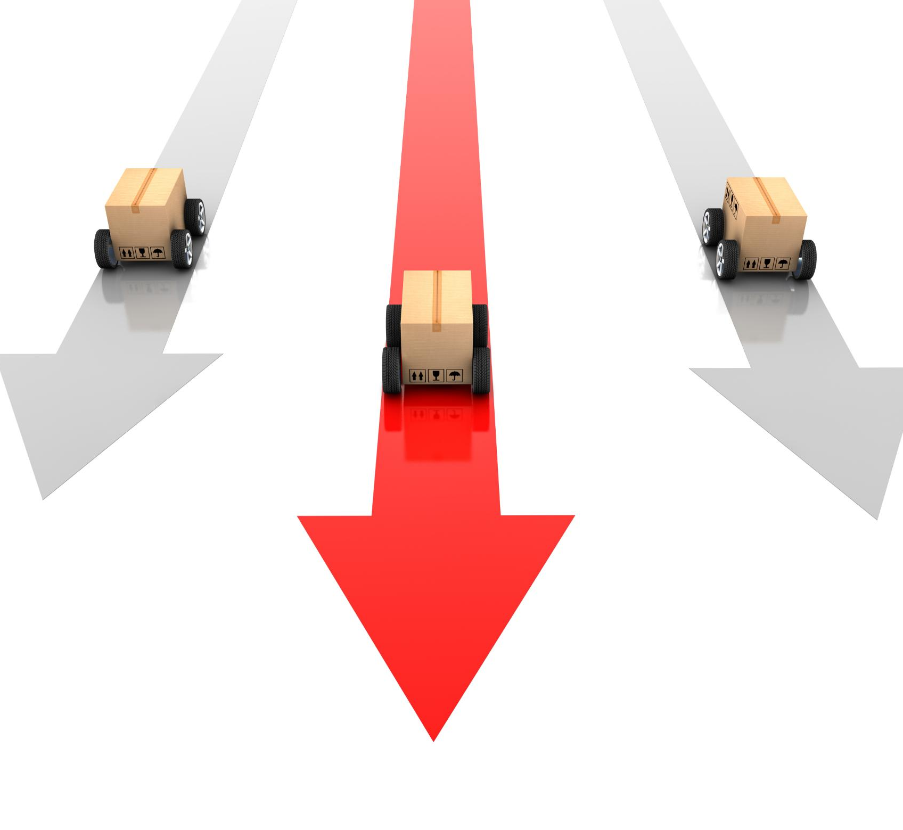
Case Study: Walmart
Implementation of RPA
  Walmart's use of RPA transformed its inventory management processes, significantly improving efficiency across the supply chain.
Streamlined Supply Chain
  The implementation of RPA led to a more streamlined supply chain, enhancing overall operational efficiency.
Reduced Stockouts
  With improved inventory management, Walmart experienced a significant reduction in stockouts, ensuring product availability for customers.
Improved Inventory Accuracy
  The use of RPA has also led to improved inventory accuracy, minimizing discrepancies and optimizing stock levels.
Notes:
Walmart implemented RPA for inventory management, leading to a more streamlined supply chain, reduced stockouts, and improved inventory accuracy.

Slide 12
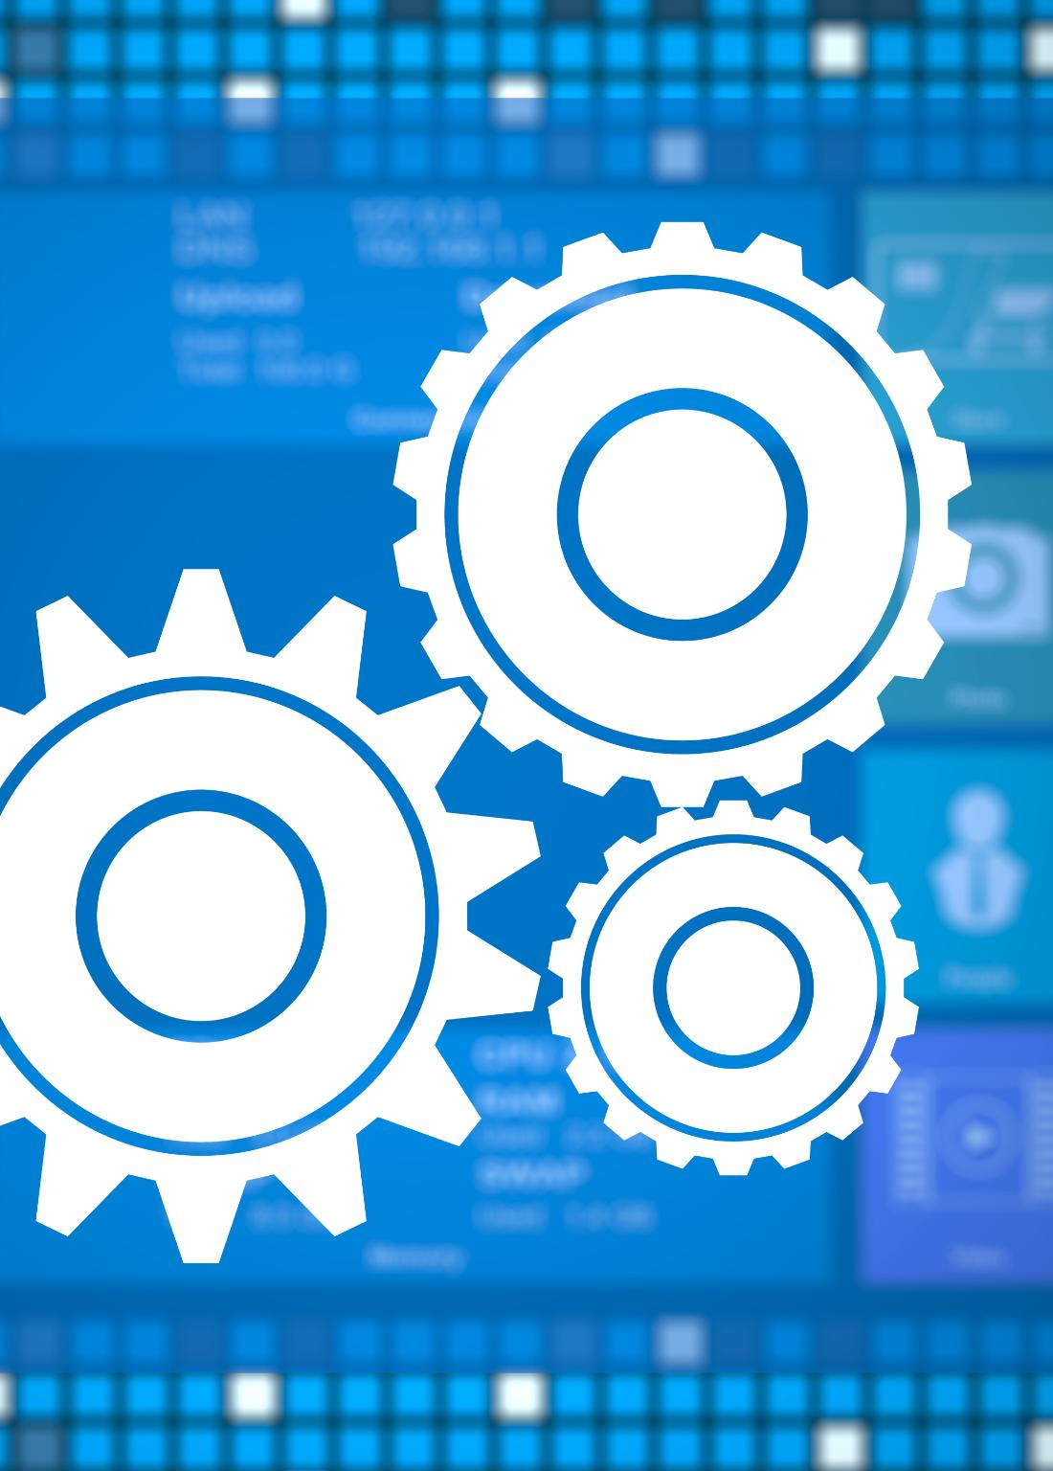
Manufacturing Industry Example
Supply Chain Management
  RPA optimizes supply chain management by automating order processing and inventory tracking, leading to efficiency.
Quality Control
  RPA enhances quality control processes by automating inspection and reporting, ensuring higher product standards.
Production Scheduling
  RPA improves production scheduling by automating task assignments and timelines, reducing downtime significantly.
Notes:
In manufacturing, RPA is used for supply chain management, quality control, and production scheduling, resulting in reduced downtime and increased productivity.

Slide 13

Case Study: Siemens
RPA Implementation
  Siemens implemented Robotic Process Automation (RPA) to enhance efficiency in its supply chain operations.
Order Processing Time Reduction
  The automation led to a remarkable 50% reduction in order processing time, significantly improving operational efficiency.
Streamlined Supplier Communications
  RPA facilitated smoother and faster communication channels with suppliers, enhancing collaboration and responsiveness.
Notes:
Siemens employed RPA to automate its supply chain processes, achieving a 50% reduction in order processing time and streamlined communications with suppliers.

Slide 14
Telecommunications Industry Example
Customer Onboarding Efficiency
RPA significantly improves the efficiency of customer onboarding processes in telecommunications, reducing time and effort.
Service Provisioning Enhancement
RPA enhances service provisioning by automating routine tasks, ensuring faster and more reliable service delivery.
Billing Process Automation
Automation of billing processes through RPA leads to increased accuracy and reduced errors in billing statements.
Notes:
RPA streamlines customer onboarding, service provisioning, and billing processes in telecommunications, helping companies enhance service delivery.

Slide 15

Case Study: Vodafone
Automation of Customer Service
  Vodafone utilized Robotic Process Automation (RPA) to streamline customer service inquiries effectively.
Reduced Response Times
  By implementing RPA, Vodafone achieved an impressive reduction in response times by 80%, leading to faster resolutions.
Improved Customer Satisfaction
  The integration of RPA not only improved efficiency but also significantly enhanced customer satisfaction ratings.
Notes:
Vodafone integrated RPA to automate customer service inquiries, reducing response times by 80% and improving customer satisfaction ratings significantly.

Slide 16

Insurance Industry Example
Underwriting Process
  RPA automates the underwriting process, leading to faster assessments and improved accuracy in risk evaluation.
Claims Processing
  Robotic process automation streamlines claims processing by reducing manual tasks and speeding up claim approvals.
Regulatory Compliance
  RPA helps ensure regulatory compliance by automating data collection and reporting, minimizing the risk of errors.
Notes:
In the insurance sector, RPA aids in underwriting, claims processing, and regulatory compliance. This enhances operational efficiency and minimizes errors.

Slide 17

Case Study: AXA
RPA Implementation
  AXA implemented robotic process automation (RPA) to enhance the efficiency of its claims processing operations.
Faster Claims Resolution
  The use of RPA allowed AXA to resolve claims much faster, benefiting both the company and its customers.
Enhanced Customer Experience
  AXA's adoption of RPA led to significantly improved customer experiences, streamlining communication and service delivery.
Notes:
AXA leveraged RPA for its claims processing, resulting in faster claims resolution and significantly improved customer experiences.

Slide 18

RPA in Government
Data Entry Automation
  RPA streamlines data entry processes in government agencies, reducing manual workload and errors.
Application Processing
  RPA facilitates faster processing of applications, improving efficiency in government services.
Records Management
  Government agencies utilize RPA for efficient management of records, ensuring compliance and easy access.
Notes:
Government agencies use RPA for data entry, processing applications, and managing records to improve service delivery and compliance.

Slide 19

Case Study: The UK Government
Adoption of RPA
  The UK Government implemented Robotic Process Automation (RPA) to streamline administrative functions across various departments.
Cost Savings
  Automation through RPA has led to significant cost reductions in government operations by minimizing manual tasks.
Improved Service Outcomes
  RPA has enhanced service delivery outcomes by increasing efficiency and accuracy in government processes.
Notes:
The UK Government adopted RPA to automate administrative tasks across various departments, leading to cost savings and improved service outcomes.

Slide 20
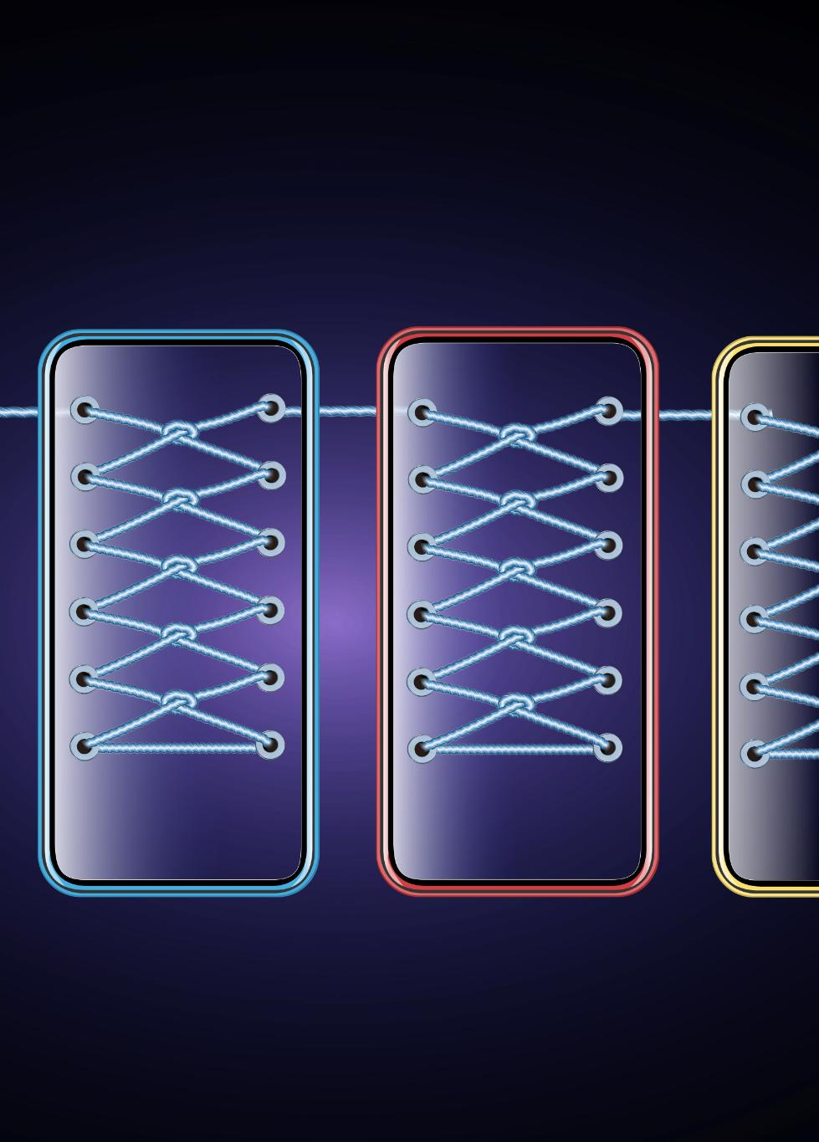
Challenges to RPA Implementation
Resistance to Change
  Organizations often face pushback from employees when implementing RPA due to fear of job loss or disruption.
Integration with Legacy Systems
  Integrating RPA with existing legacy systems can be challenging and may require significant technical adjustments.
Data Security Concerns
  Ensuring data security is crucial during RPA implementation, as automation can expose sensitive information to vulnerabilities.
Notes:
While RPA offers numerous benefits, organizations may face challenges such as resistance to change, integration with legacy systems, and ensuring data security.

Slide 21

Best Practices for RPA Success
Process Selection
  Choosing the right processes for RPA is crucial to maximizing efficiency and achieving quick wins.
Employee Training
  Investing in employee training ensures that team members are equipped with the skills needed to work alongside RPA technologies.
Change Management Strategies
  Implementing change management strategies helps to manage the transition and address any resistance from employees.
Notes:
To achieve successful RPA implementation, organizations should prioritize process selection, invest in employee training, and focus on change management strategies.

Slide 22

Future of RPA
Integration with AI
  The future of RPA will see deeper integration with artificial intelligence, enabling smarter automation processes.
Machine Learning Advancements
  With advancements in machine learning, RPA will enhance its decision-making capabilities and adaptability across various tasks.
Broader Application Range
  The evolving RPA technology will broaden its application range, impacting diverse industries and sectors significantly.
Notes:
As technology advances, RPA will evolve, integrating with artificial intelligence and machine learning to enhance capabilities and broaden its application range.

Slide 23

Conclusion
Improvements Across Industries
  RPA implementations have shown significant performance improvements in sectors like finance, healthcare, and manufacturing.
Adopting Best Practices
  Organizations that adopt best practices in RPA implementation experience higher success rates and better outcomes.
Driving Efficiency and Innovation
  Harnessing RPA's full potential drives operational efficiency and fosters innovation in business processes.
Notes:
Successful RPA implementations demonstrate significant improvements across various industries. By adopting best practices and addressing challenges, organizations can harness the full potential of RPA to drive efficiency and innovation.

